Slide 1
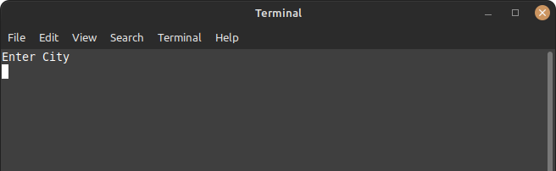
Wherether: An easy, terminal-based, weather forecast app

Slide 2
Application Function
Shows the weather of a selected city using Curl and Wttr.in
Asks user to input a city
Displays a 3-day forecast of the weather of that city, using Wttr.in’s API

Slide 3
Inspiration
Simple terminal applications like this are what help programmers and non-programmers alike who are starting linux/macOS
Using APIs is an important and exciting way to create interesting new programs using existing data

Slide 4
Curl
A popular and useful command-line tool for transferring data using various network protocols
Simple usage is $ curl website.co/ [ … ]
Doing this, you can access information from wttr.in’s API regarding weather info from around the world.

Slide 5
Read/Echo/Wait
Read: command tool to accept user input
Usage is $ read `variable_name` [ options … ]
Input is assigned to $variable_name
Echo: command tool to write to standard output
Usage is $ echo `displayed_text`
Wait: command tool to suspend system for a certain time or under certain circumstances
Usage is $ wait=(`wait_time`)

Slide 6
(sudo)Live Demonstration

Slide 7
Authors
Matt Hill
Alex Leeper
Chad Calvert

